Slide 1
Lecture 1:
Course Introduction
Programming, data science and statistics 3
Jose Segovia-Martin

Slide 2
Today’s lecture
Introductions
Course structure
Course content
Course assessment
Our expectations of you
What you can expect from us
Beginning with R and R studio

Slide 3
Welcome to PDSS3
Lecturers:
Jose Segovia-Martin
Repo:
https://github.com/jsegoviamartin/PDSS3

Slide 4







Jose Segovia-Martin
Researcher at Complex Systems Institute Paris
PhD Cognitive Science
Complex systems, cultural evolutionary methods and collective behavior
MSc Science of language and computation
Biology
Economics

Slide 5





Slide 6
Course Structure
Each week PDSS includes:
2x 1 hour lectures (both compulsory)
2x 1 hour lab
Weekly homework
1 problem set
Assigned reading

Slide 7
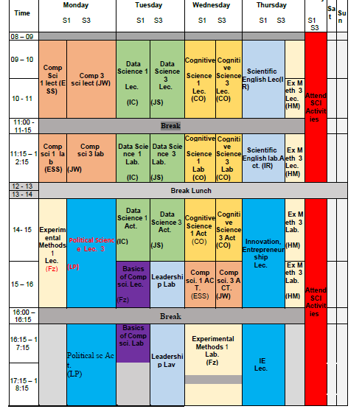
Planning your week

Slide 8
Learning
Theory: Lectures, coursework (labs), and problem sets.
Do your reading round lectures
Consolidate notes from lectures with reading
Use these to help with problem sets
Practical: Examples, problem sets and labs
Ask questions in lecture about examples.
Problem sets focus on interpretation and specification of models.

Slide 9
Problem sets
Due to the nature of the content we will be covering, there will be less hands-on calculation.
This does not mean no maths, but does mean less.
This course focusses more on interpretation and specification of models.
How do I set up an analysis to answer my primary research questions?

Slide 10
If you struggle….
Do your best to follow the suggested weekly
schedule.
If you get stuck:
Ask questions in class and labs
Work with friends and help each other.
Do not wait weeks and weeks to seek help.

Slide 11
Course content
Models:
Intro to Rstudio, R.
Simple and multiple regression refresher
Coding models within regression
Mixed effects models
Equation based models (ordinary differential equations)
Agent based models
Model building – Neural Networks

Slide 12
Course content
Models:
Intro to Rstudio, R.

Slide 13
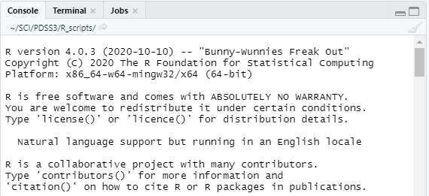
Course content
R is a statistical programming language that has rapidly gained popularity in many scientific fields. It was developed by Ross Ihaka and Robert Gentleman as an open source implementation of the “S” programming language.

Slide 14
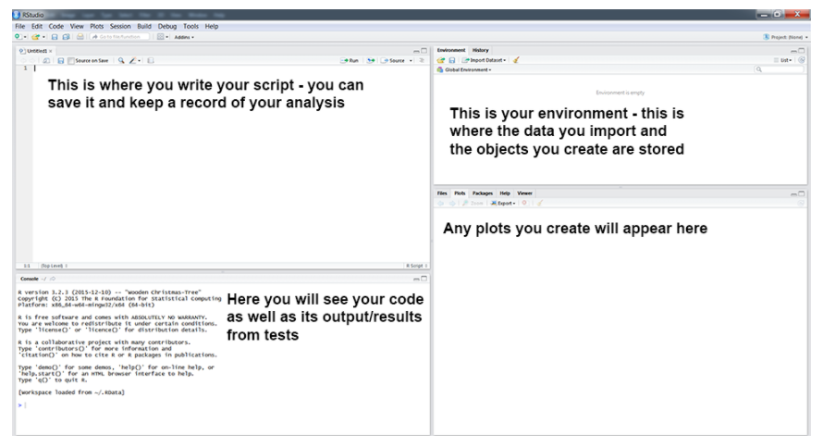
Course content
RStudio is an Integrated Development Environment (IDE) for R, a programming language for statistical computing and graphics.

Slide 15
Course content
Models:
Intro to Rstudio, R.
Simple and multiple regression refresher

Slide 16
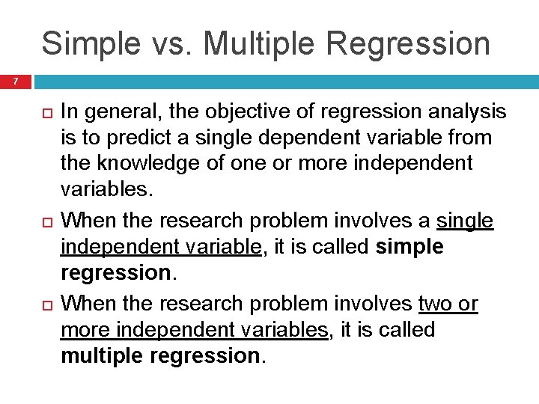
Course content

Slide 17
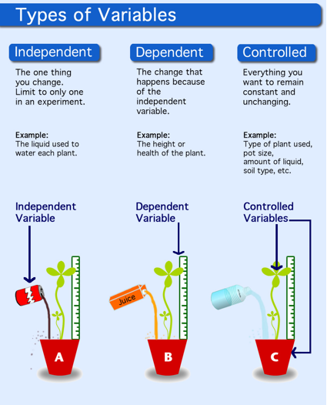
Course content

Slide 18
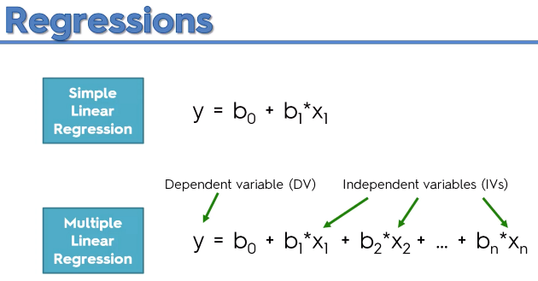
Course content
Estimate of the intercept
(the expected mean value of Y when all X=0)
Estimate of the slope
(the rate at which y is changing with respect to x)

Slide 19
Course content
Models:
Intro to Rstudio, R.
Simple and multiple regression refresher
Coding models within regression
Mixed effects models

Slide 20
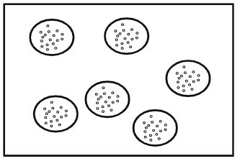
Course content
Linear mixed models are an extension of simple linear models to allow both fixed and random effects, and are particularly used when there is non independence in the data, such as arises from a hierarchical structure. For example, students could be sampled from within classrooms, or patients from within doctors.
When there are multiple levels, such as patients seen by the same doctor, the variability in the outcome can be thought of as being either within group or between group. Patient level observations are not independent, as within a given doctor patients are more similar. Units sampled at the highest level (in our example, doctors) are independent. The figure below shows a sample where the dots are patients within doctors, the larger circles

Slide 21
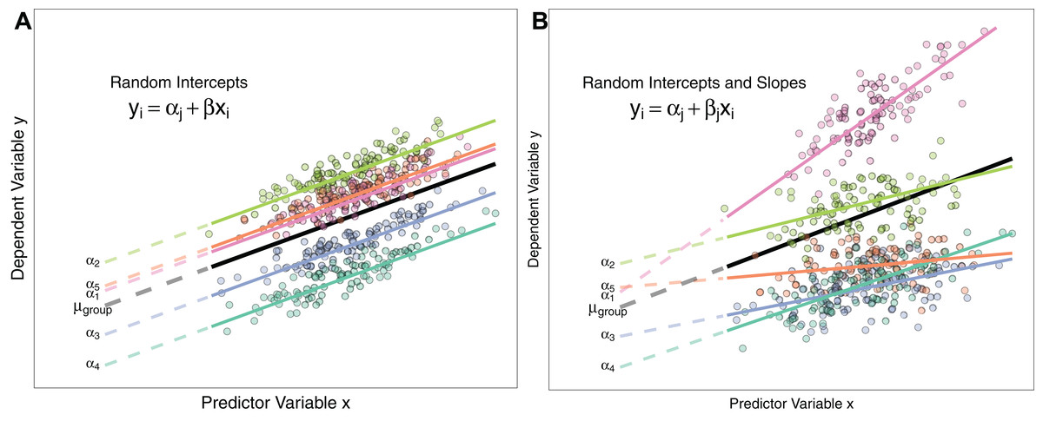
Course content

Slide 22
Course content
Models:
Intro to Rstudio, R.
Simple and multiple regression refresher
Coding models within regression
Mixed effects models
Equation based models (ordinary differential equations)

Slide 23
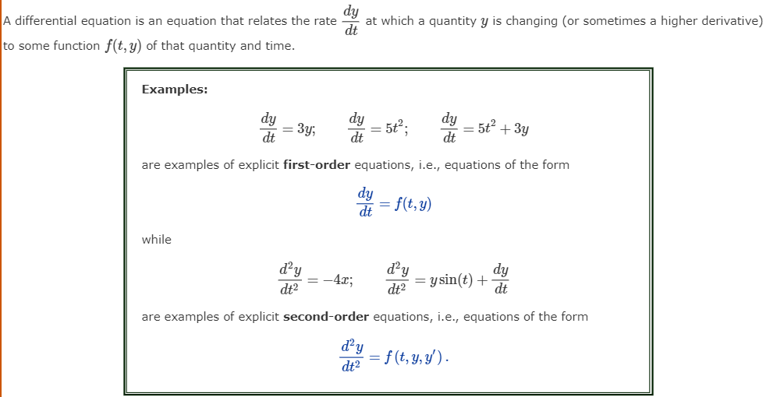
Course content

Slide 24
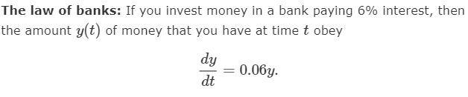
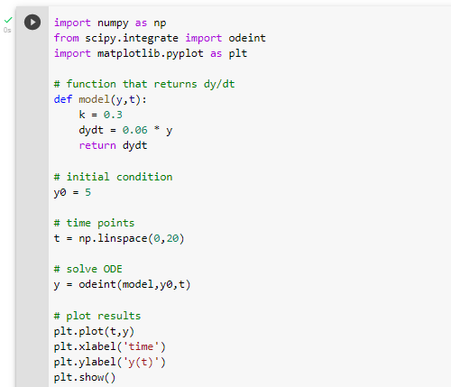
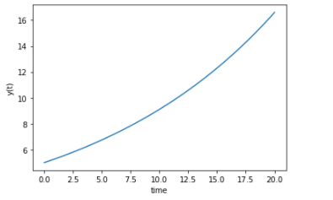
Course content

Slide 25
Course content
Models:
Intro to Rstudio, R.
Simple and multiple regression refresher
Coding models within regression
Mixed effects models
Equation based models (ordinary differential equations)
Agent based models
Model building – Neural Networks

Slide 26
Assessment
Problem sets – (homework) (25%)
Problem sets: submissions are due on a weekly basis. Make sure you send it after the session or before Friday.
Coursework – Labs (25%)
Write up of a data analysis using methods you will learn in this course: Submission of the code developed during the lab. Make sure you send it after the session or before Friday.
Do the reading.
Assignments.
• Exam (50%):
2 hour exam in the winter exam block covering all aspects of the course

Slide 27
Homework (25%)
First week does not count towards your mark:
Content will be baby steps with R and R studio.

Slide 28
Coursework (25%)
Each week you will get a Problem set.
Mix of theory, calculations, interpretation and R.

Slide 29
What we expect of you
Work hard
It will require more hours per week than you are used to.
Be an active learner
Interact with us - particularly if you are struggling.
Ask questions in class and labs
Communicate appropriately

Slide 30
Communication
It is hard to answer stats questions via email.
Always make sure emails have:
Informative subject lines
Say who you are and what course you are on
State your issues as best you can.
Talk to your classmates.
Other students may have had, or may have in the future, the same problem. Be a community.

Slide 31
Tasks for this week…
LAB 1:
LAB 1 A
Getting started with R and R studio:
https://ourcodingclub.github.io/tutorials/intro-to-r/
LAB 1 B
Simple math with R
Activity - Homework: Problem set 1
Reading:
Go over last years regression lecture notes
Add your name to the github classroom (now)
Accept invitation: https://classroom.github.com/a/XvcIQC_A
Submit your activity-homework (Problem set 1) in github classroom

Slide 32
Introduction to R
Why R?
R is the de facto standard in the social sciences.
R vs traditional statistical proprietary software (e.g. SPSS)
More jobs
Reproducible practices
Learning curve
No licensing hassle
Data processing

Slide 33
Introduction to R
Base R & Tydiverse
Two dialects
Which style should you learn?

Slide 34
Introduction to R
Important packages
install.packages('tidyverse')
install.packages('broom')
install.packages('gridExtra')
install.packages('car')
install.packages('MASS')
install.packages('pscl')
install.packages('effsize')
install.packages('lme4')
install.packages('afex')
install.packages('brms')
install.packages('MuMIn')
install.packages('swirl')
install.packages('languageR')
install.packages('emmeans')

Slide 35
Introduction to R
What are we going to use R for?
Regression modelling
I assume a basic knowledge of the mathematics underlying regression. But, don't panic, we will explain the basic mathematics we study from the ground up.

Slide 36
Statistics
Making datasets amenable to human cognition
Preprocessing and analysis
We need R: the ability to type in programming commands, rather than dealing with the data exclusively via some graphical user interface.

Slide 37
Statistics
What could go wrong when using a graphical interface?
Reproducibility and replicability
Spreadsheet errors (e.g. Reinhart and Rogoff (2010))

Slide 38
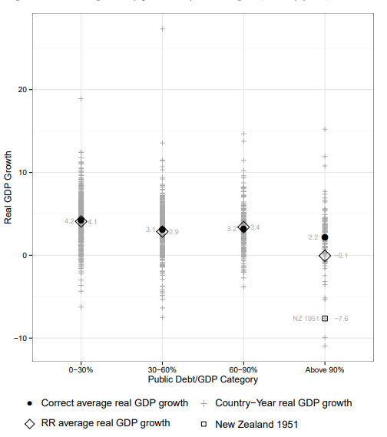
Statistics
Spreadsheet errors (e.g. Reinhart and Rogoff (2010))
At one point R&R set cell L51 equal to AVERAGE(L30:L44) when the correct procedure was AVERAGE(L30:L49). They left Denmark, Canada, Belgium, Austria, and Australia out of the average. When you fix the Excel error, a -0.1 percent growth rate turns into 0.2 percent growth. See the article for a picture of the error.
Source
The European Spreadsheet Risks Interest Group elaborates a long list of
spreadsheet “horror stories”

Slide 39
Hands-on lab
LAB 1 A
Getting started with R and R studio:
https://ourcodingclub.github.io/tutorials/intro-to-r/
LAB 1 B
Simple math with R
https://github.com/jsegoviamartin/PDSS3
ACTIVITY 1
Problem_set_1
https://github.com/jsegoviamartin/PDSS3
Accept invitation: https://classroom.github.com/a/XvcIQC_A
Submit your activity-homework (Problem set 1) in github classroom
ACTIVITY 2
Search in your search engine for "The European Spreadsheet Risks Interest Group", find the "Horror stories" section and look for a story that contains an error associated with the use of Excel. Study the case and share it with your classmates in a 5-minute presentation.

Slide 40
